Slide 1
MIS775 – DECISION MODELLING FOR BUSINESS ANALYTCS
Assignment 2
Presented by: Ba Huy Hoang Le
Student ID: s224309594

Slide 2
Introduction
Case Context
Objective
Coastal Nest Motel: A 20-unit boutique, Airbnb-style property on a popular beachside route in Melbourne
Preparing for three peak-season windows (Dec 1 – Feb 28/29) over 2022– 2025
Management seeks a spreadsheet-based decision model to balance occupancy, pricing, overbooking, and risk
Build Model Structure
Scenario Analysis
Distribution and Simulation
Risk Analysis
Recommendations

Slide 3
2. Model Description
Model Description
The model integrates four sources of uncertainties with three managerial levers and five fixed input parameters. It simulates each day’s occupied rooms, bumped guests, revenues, and costs to deliver two key metrics.
Stochastic Inputs
Fixed Inputs
Decision Variables
Daily online reservations
Late-cancellation percentage
Walk-in arrivals
Miscellaneous expense
Total number of rooms
Utilities cost
Housekeeping cost
Management and marketing cost
Check-in staff cost
Room nightly rate
Over-booking level
Late cancellation fee
Output metrics
Total daily profit
Sold-out status
Decision Variables

Slide 4
2. Model Description
Fixed input (constants)
Decision variables (inputs)
Calculated variables
Output variable
Stochastic inputs
Bumped guests
Conceptual Model
Daily Online Reservations
Late cancellation percentage
Walk-in arrivals
Net Demand
Room nightly rate ($)
Revenue from stays
Total fixed inputs cost
Total Daily Profit
Overbooking level
Room sold
Total utilities cost
Total room available
Utilities cost per occupied room
Late cancellation fee revenue
Total housekeeping cost
Housekeeping cost per occupied
Late no shows
Late-cancellation fee (%)
Sold Out: Yes/ No
Total compensation cost
Bumped guests
Miscellaneous daily expenses
Management and marketing fee per occupied room
Check-in staff cost per day

Slide 5
2. Model Description
General Assumptions
All reservations are for one night only
Every unit is identical in size, amenities, and rate
All advance bookings lodge exactly one day before arrival
No shows free capacity immediately for walk-ins
Only fill rooms vacated by cancellations or over-booking slots
No group or multi-room reservations

Slide 6
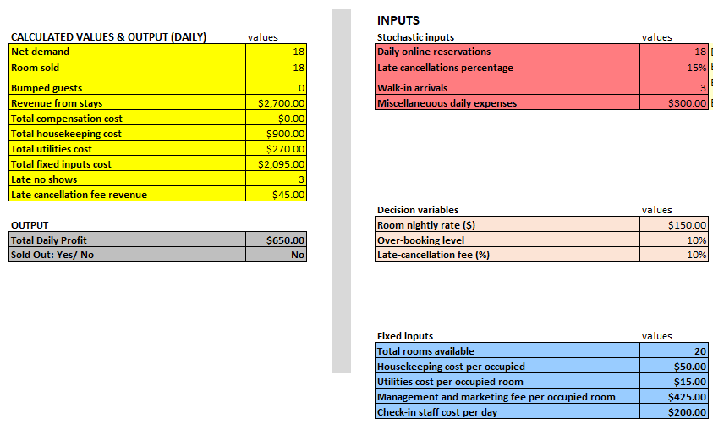
3. Spreadsheet-based Decision Model

Slide 7
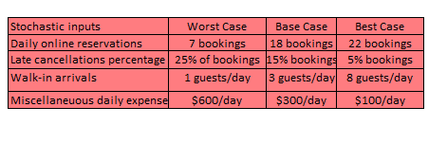
4. Scenario Analysis
Primary Decision Variable: Room Nightly Rate
Over-booking level and Late Cancellation Fee are kept constant
Justification
A small rate change scales directly with every occupied room, driving far profit and loss fluctuations than changes to over-booking or cancellation fees.
Price is the market’s clearest lever, which means raising or lowering it immediately changes both advanced bookings and walk-ins.
By holding over-booing and cancellation fee policies steady, the motel can isolate how rate alone affects occupancy, profit, and sold-out likelihood, which guides its core pricing strategy
Scenario Table

Slide 8
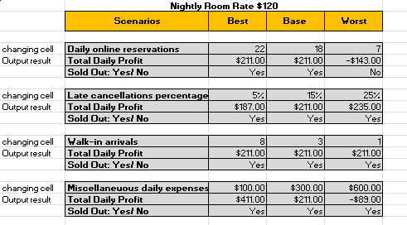
4. Scenario Analysis
Room Price at $120
If post-cancellation demand ≥ 14, we sell all 20 rooms and earn $211/day. Below 7 bookings, we underfill and incur a $143 loss.
Higher no-shows (25%) raise profit to $235 by freeing rooms for spill-over sales plus fee income; low no-shows (5%) cut profit $187 by forfeiting those benefits.
With 15 advance arrivals and 10% over-booking, even 1 walk-in ensures 20 rooms sold, so profit stays fixed at $211 regardless of spill.
Varying $100 to $600 swings profit from $141 down to -$81, since full occupancy makes these expenses the sole driver of daily margin

Slide 9
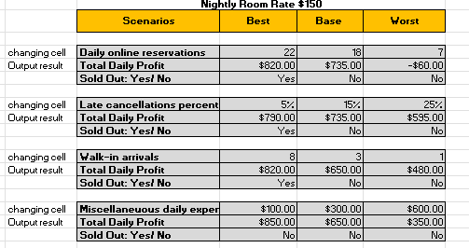
4. Scenario Analysis
Room Price at $150
At 18 bookings, we only sell 18/22 rooms for $735 profit; 21 bookings onwards unlocks the $820 “best” outcome.
Low no-shows (5%) net 20 rooms and $790; high no-shows (25%) drop sales below capacity and profit to $595.
Need at least 4 walk-ins to hit the 22-room cap; fewer spill leaves rooms empty and profit falls to $650 or $480.
A $100 to $600 range swings profits by $500, directly impacting bottom line when underfilled.

Slide 10
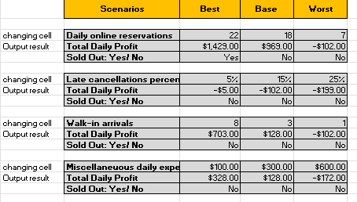
4. Scenario Analysis
An 8-person spill raises profit only to $703, still below peak; average spill (3) yields just $128, and fewer arrivals drive losses.
Room Price at $180
Only peak demand (22) unlocks the $1,429 upside at $180/night. Base demand (18) falls to $969 profit, and 7 bookings swings us into a $102 loss.
Even low no-show rates can’t fill 20 rooms, so penalty fees never cover the lost revenue—profit remains negative across realistic cancellation scenarios.
An 8-person spill raises profit only to $703, still below peak; average spill (3) yields just $128, and fewer arrivals drive losses.
A $500 swing in miscellaneous costs ( $100→$600 ) shifts us from a small gain ($328) to a $172 loss, with no occupancy buffer to absorb the hit.

Slide 11
4. Scenario Analysis
An 8-person spill raises profit only to $703, still below peak; average spill (3) yields just $128, and fewer arrivals drive losses.
Brief conclusion
A $150 nightly room rate delivers the best balance of risk and reward: a strong average profit ($735), full occupancy in base and upside ($820) in peak, while capping worst-case losses (-$60). Lower ($120) margins are too thin, higher ($180) yields volatile swings and frequent losses.

Slide 12
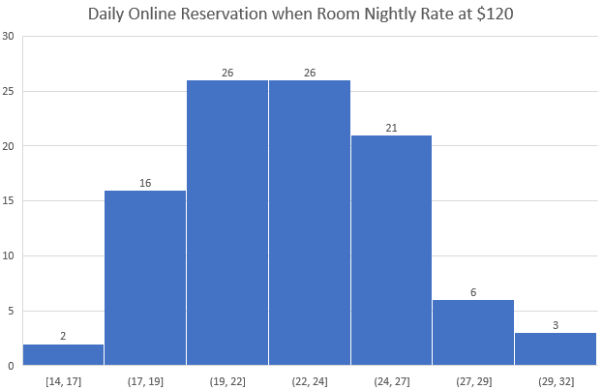
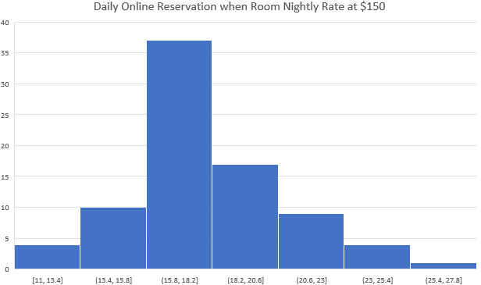
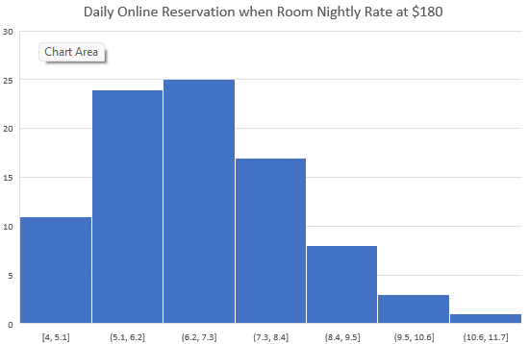
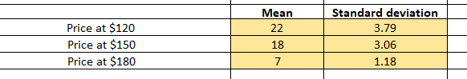
5. Stochastic Inputs
Daily Online Reservation
Three peak holiday seasons of “advance‐booking” data cluster around each price‐point mean and exhibit a roughly symmetric, bell-shaped spread. The historical counts show symmetrical and near symmetrical distribution around the mean with few extreme outliers, showing that Stochastic Input 1 follows normal distribution

Slide 13
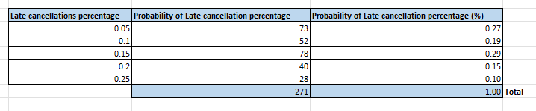
5. Stochastic Inputs
Late Cancellation Percentage
Three peak‐season data show cancellation rates clustering exactly at 5 %, 10 %, 15 %, 20 % and 25 %, with observed frequencies of 27 %, 19 %, 29 %, 15 % and 10 % respectively. Because these rates occur in fixed policy tiers rather than a smooth continuum, and our sample counts match those discrete values, modelling late‐cancellation percentage with an empirical distribution directly reflects the pattern without forcing it into a theoretical curve.

Slide 14
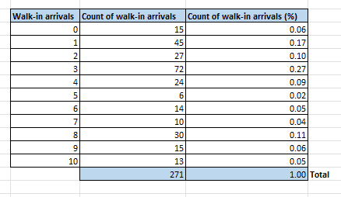
5. Stochastic Inputs
Walk-in Arrivals
Our historical data show walk-in counts occurring exactly at 0, 1, 2, 3, 4, 5, 6, 7, 8, 9 and 10 guests with frequencies of 6 %, 17 %, 10 %, 27 %, 9 %, 2 %, 5 %, 4 %, 11 %, 6 % and 5% respectively. These discrete, policy-driven patterns reflect real-world surges and quiet days that do not fit a smooth theoretical curve. Modelling walk-in arrivals with an empirical distribution preserves these exact observed frequencies and ensures our simulations accurately mirror actual guest behaviour.

Slide 15
5. Stochastic Inputs
Daily Miscellaneous Expenses
Miscellaneous daily expenses have no clear central tendency but fluctuate evenly between minor run-of-house costs ($100) and rare “perfect storm” spikes ($600). A uniform distribution on [100, 600] reflects this equal likelihood across the full range of plausible daily incidentals when no further pattern is evident.

Slide 16
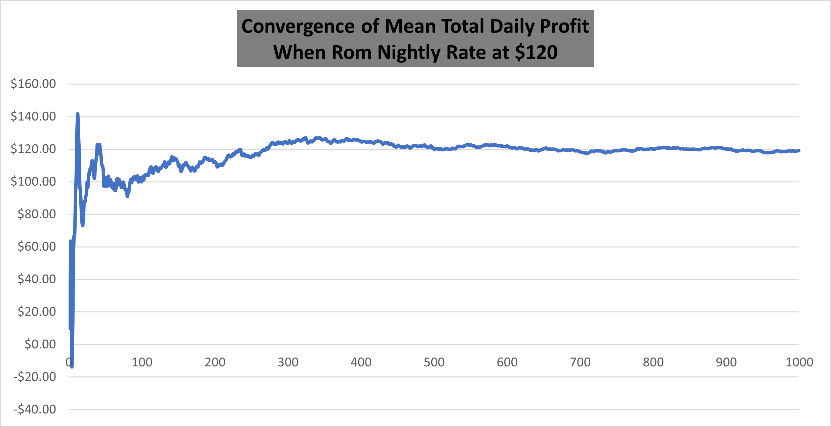
6. Simulated Output Distribution
+$140 as individual extreme days dominate the average.
First 50 runs swings wildly between -$40 and +$140 as individual extreme days dominate the average.
Between 50 to 300 runs the mean climbs into the $110 to $130 band and fluctuations shrink rapidly.
From 400 runs onwards, the average profit converges tightly around $120/day with +/-$5 variability even out to 1000 simulations.

Slide 17
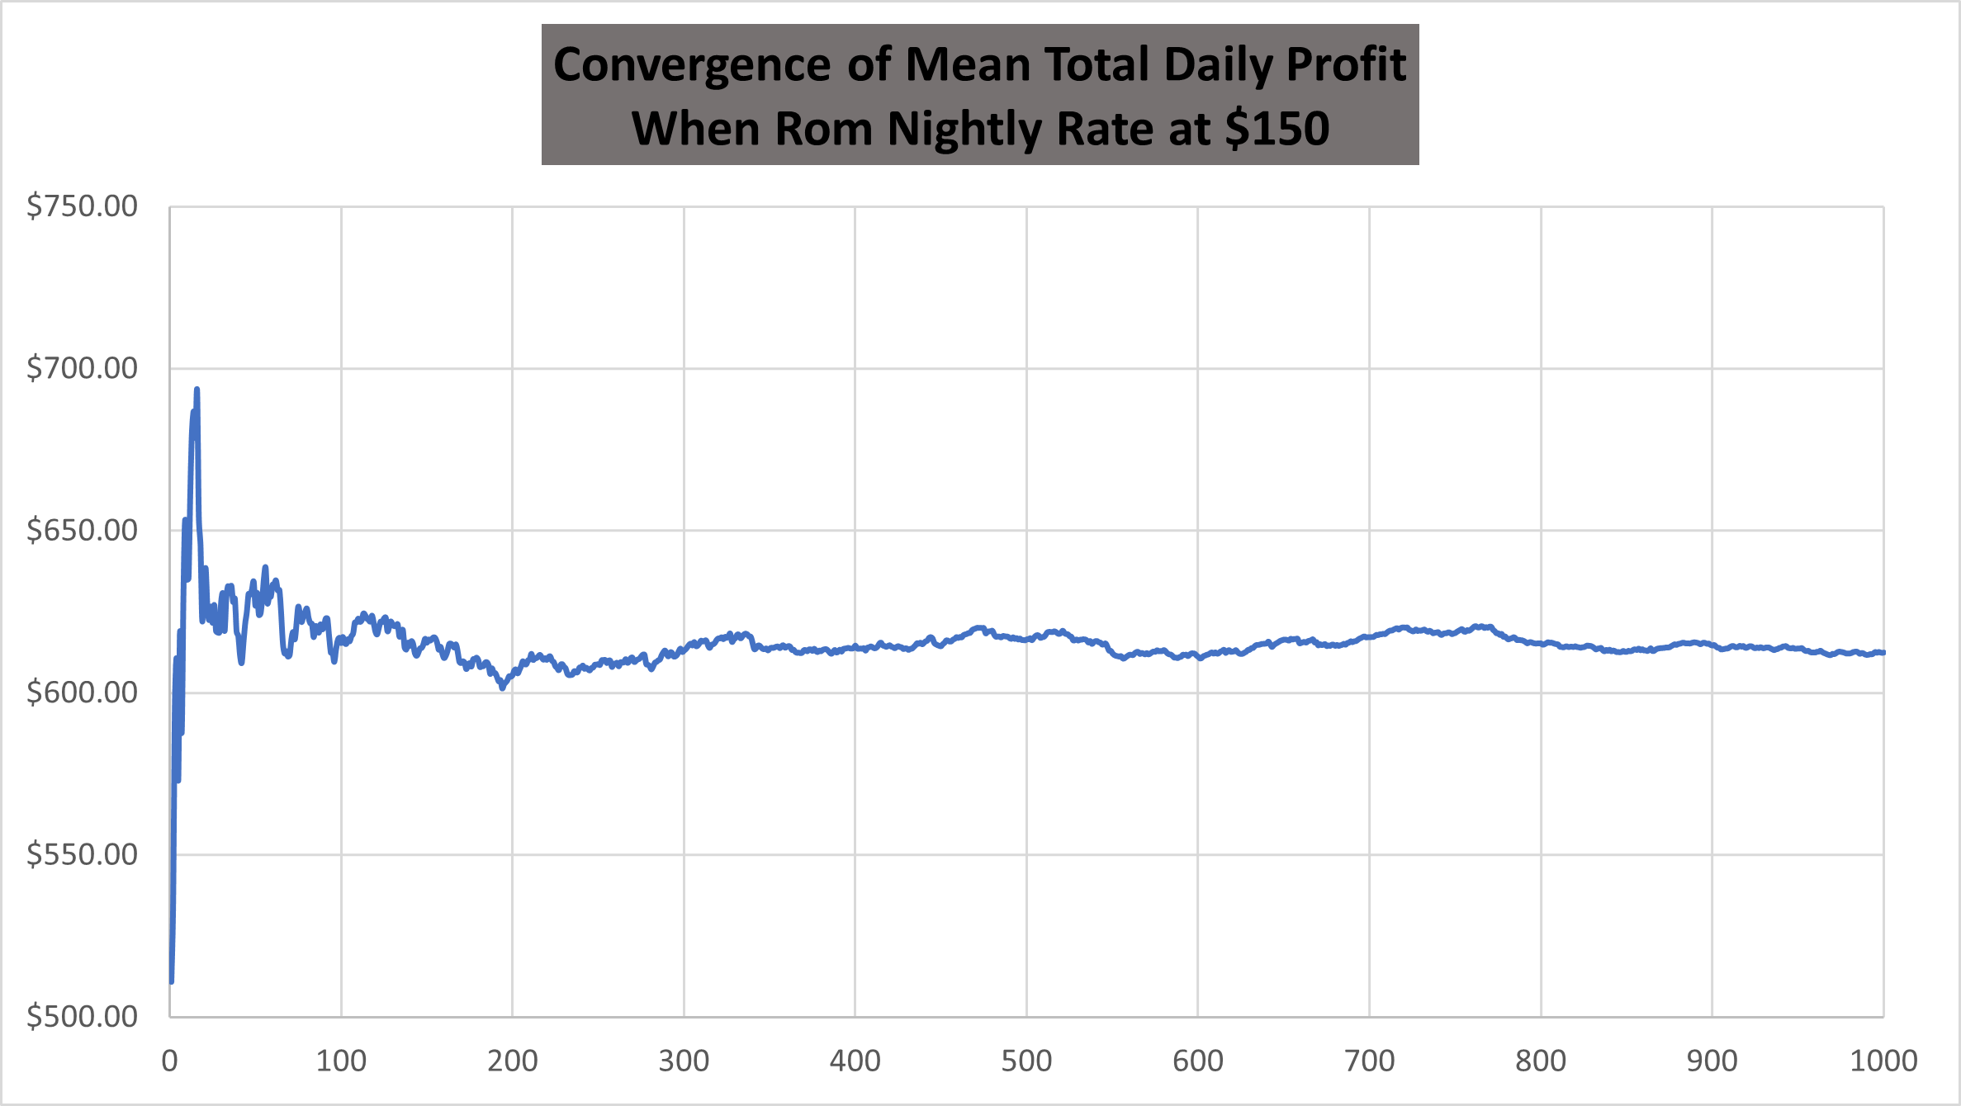
6. Simulated Output Distribution
The running mean jumps from about $500 up to nearly $680, reflecting high variance in early draws.
Fluctuations narrow into the $600–$640 band as outlier days average out.
Beyond 300 simulations, the mean profit stabilizes around $615/day, with only ±$5 drift out to 1,000 trials.

Slide 18
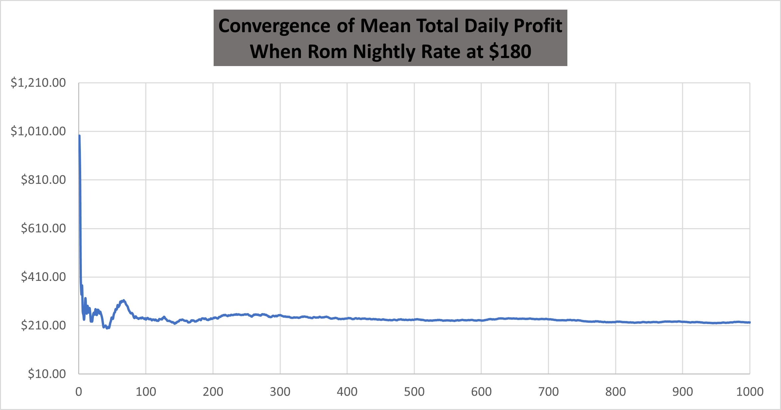
6. Simulated Output Distribution
The running mean plummets from ~$1 000 to below $300 as large losses dilute early wins.
Fluctuations settle into the $200–$300 range, driven by frequent under‐filled days.
Beyond ~200 trials, the average profit converges around $230/day, with minimal drift through 1 000 simulations.

Slide 19
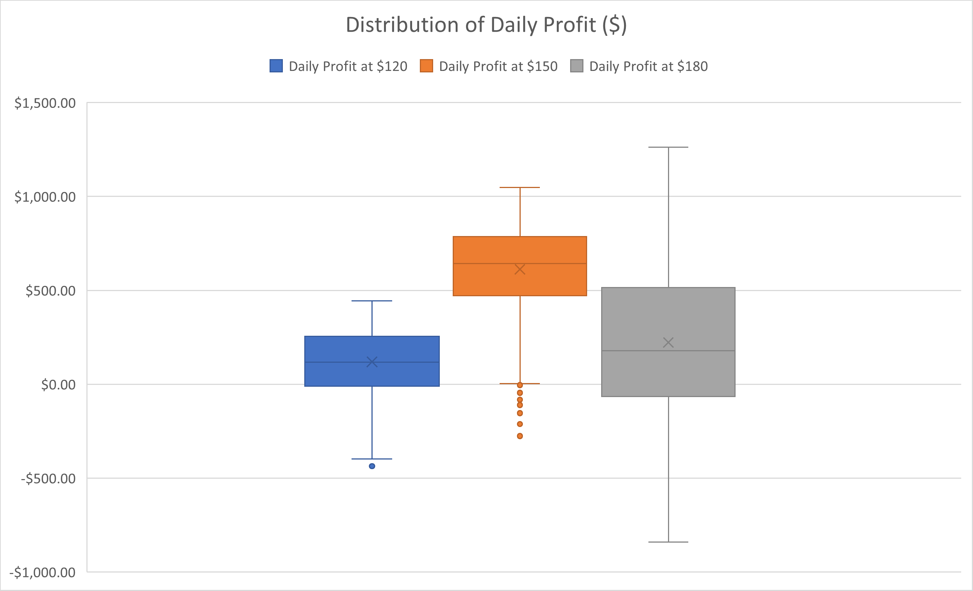
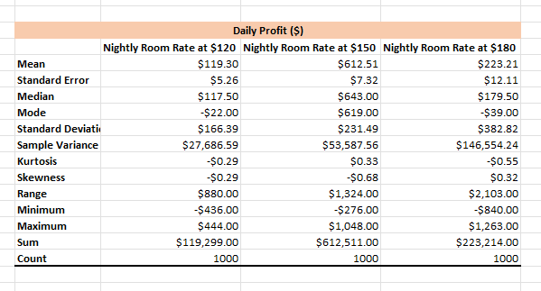
6. Simulated Output Distribution
At $120 per night, profits cluster around $119 daily, with upside capped at $444 and losses down to –$436. The nearly symmetric spread reflects consistent, modest returns.
At $150 per night, average profit rises to $613 and the median to $643. Downside risk narrows (minimum –$276) while volatility allows occasional gains above $1 000 without large swings downward.
At $180 per night, mean profit drops to $223 despite the higher rate. The range expands dramatically, with losses reaching –$840 and peak profits of $1 263, showing most days underperform the mean punctuated by rare extreme gains.

Slide 20
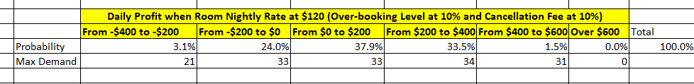
7. Risk Analysis
Room Price at $120
A 27 percent probability of any loss, including a 3 percent chance of a severe loss between $200–$400.
A 73 percent probability of non-negative profit, with two-thirds of profitable days delivering $0–$400.
Negligible upside beyond $600 – no simulated day exceeded that threshold
Occupancy shortfalls on low-booking days drive losses, while walk-ins and over-booking cap out profit around $400. This means $120 is a conservative rate: it offers modest, reliable gains most days but leaves little room for outsized returns and carries a meaningful one-in-four risk of loss.

Slide 21
7. Risk Analysis
Room Price at $150
Only 1.4% chance of any loss (0.2 % deep losses of $200–$400; 1.2 % losses up to $200).
57 % of days earn $600–$1 000
No days exceeded $1 200.
The $150 rate virtually eliminate daily losses (<2% probability) while delivering strong profits on 97% of days. Over half of the profitable days yield $600–$1 000, providing a robust buffer against cost fluctuations. This rate maximizes average revenue with very low risk, making it the clear optimal choice

Slide 22
7. Risk Analysis
Room Price at $180
32% chance of a loss
68% chance of modest to strong profit
No days exceed $1400
A one-in-three chance of loosing money makes $180 rate a high-risk rate. Profits, when they occur, are spread across wide bands but seldom exceed $1 200. This rate’s volatility requires stronger demand guarantees or hedges if chosen.

Slide 23
8. Conclusion
$150/nighy is the optimal rate during peak holiday seasons. It delivers a high average profit ($613/day), fills nearly all rooms under base demand, and carries <2% probability of any loss. Over half of profitable days generate $600–$1 000, providing robust upside with minimal downside.
$120/night is too conservative. It Yields only $119/day on average and a 27% chance of any loss.
$180/night is too volatile. Average profit falls to $223/day with a 32% loss probability.
Price at $150 for upcoming peak season
Maintain 10% over-booking and cancellation fee
Monitor live booking curves

